Slide 1
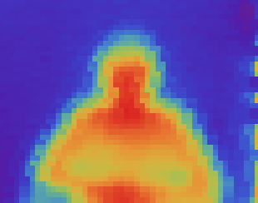
Single-Pixel Thermal Imaging Solution
Develop a low-cost thermal imaging system using a single-pixel, non-contact thermometer
Joshua Alexander
EECE 6038C - Advanced Microsystems
Spring 2016

Slide 2
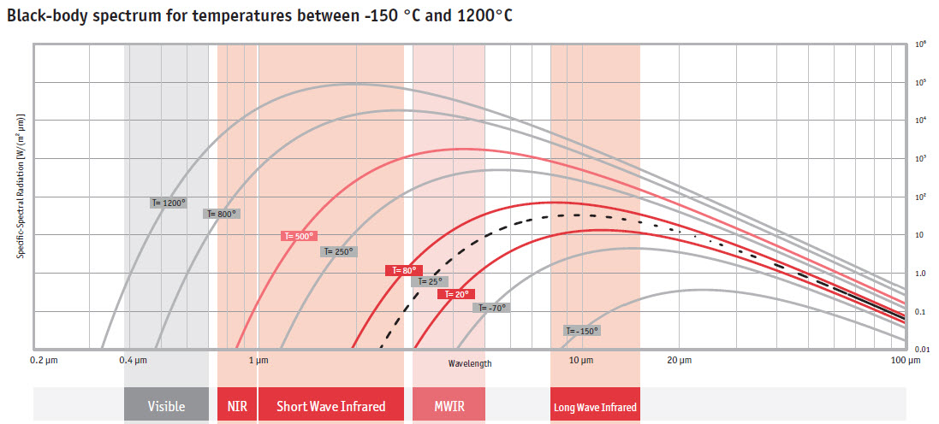
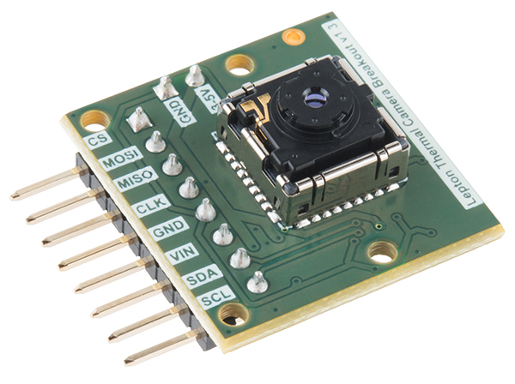
Background
Thermal image data is underutilized, many potential avenues
Computer vision supplement
Home efficiency audits
Existing thermal imaging solutions are very expensive
Thermal sensor ICs alone are >$250 (FLIR development kits)
Others do not offer true capture of medium wavelength infrared signals
Many applications do not utilize fast imaging techniques
Low-refresh rates/low resolutions may be acceptable

Slide 3
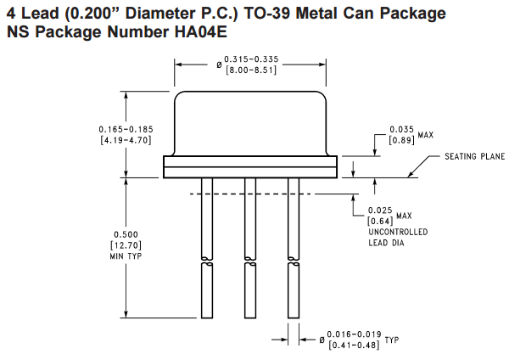
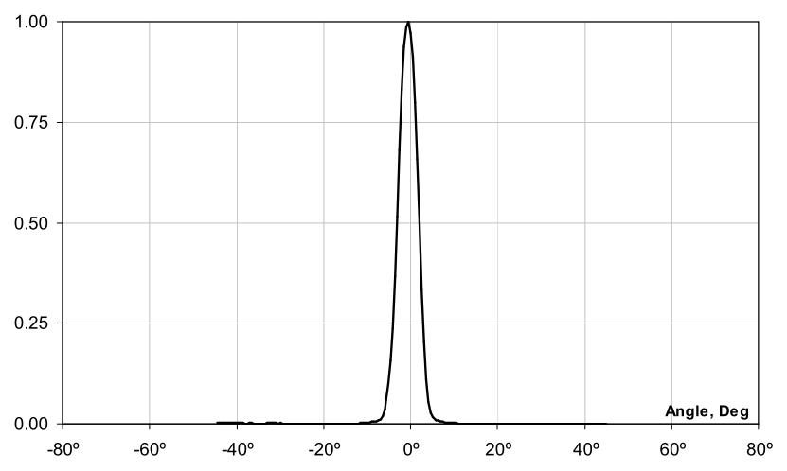
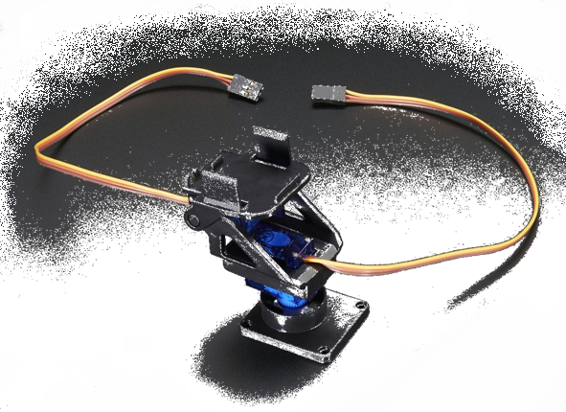
Design (Sensor and Gimbal)
Develop a low-cost thermal imaging using a single-pixel, non-contact thermometer
Melexis MLX90614 (MLX90614ESF-DCI-000-TU)
5° FOV
Resolution of 0.02°C
Temperature range of -40°C to 85°C
Dual servo pan tilt mechanism to steer sensor

Slide 4
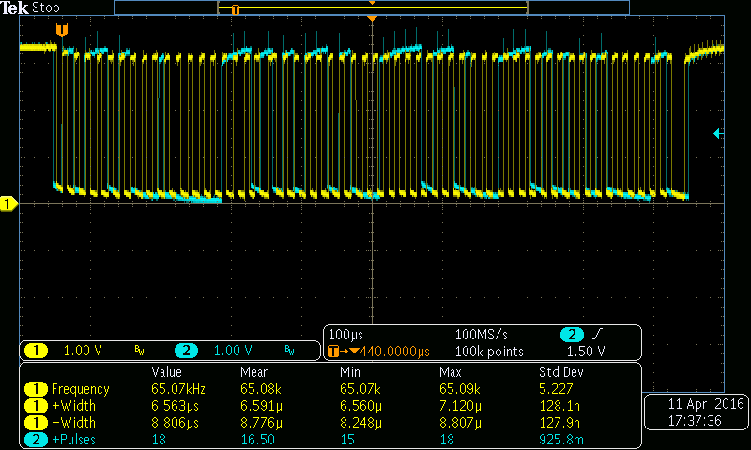
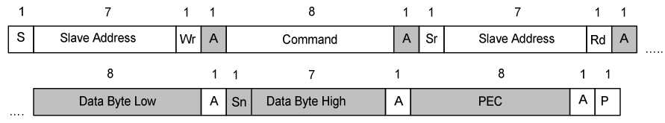
Design (MCU)
Microchip 16-bit PIC MCU chosen (PIC24FJ128GB202-I/SP-ND
I²C ability
USB connectivity (for PC HID interface and debugging)
PWM support (for servos)
Six 10-bit ADCs
128KB of program memory

Slide 5
Design (Hardware Overview)

Slide 6
Design (Firmware Logic)
All firmware code written in C
MPLAB X IDE used for development and in-circuit debugging

Slide 7
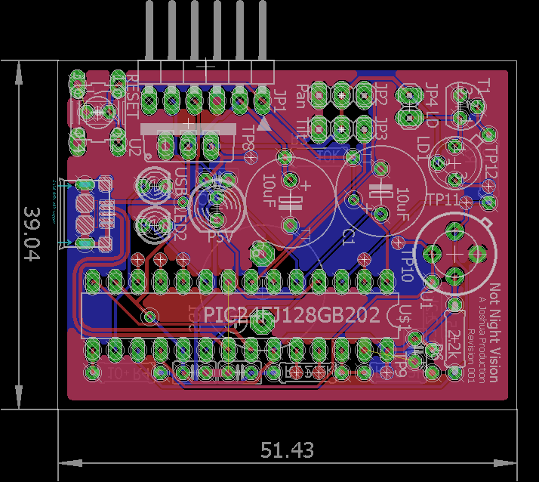
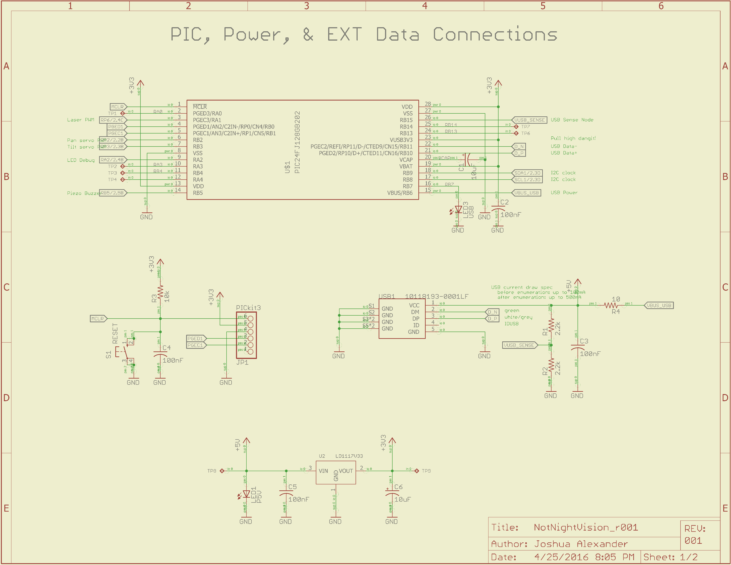
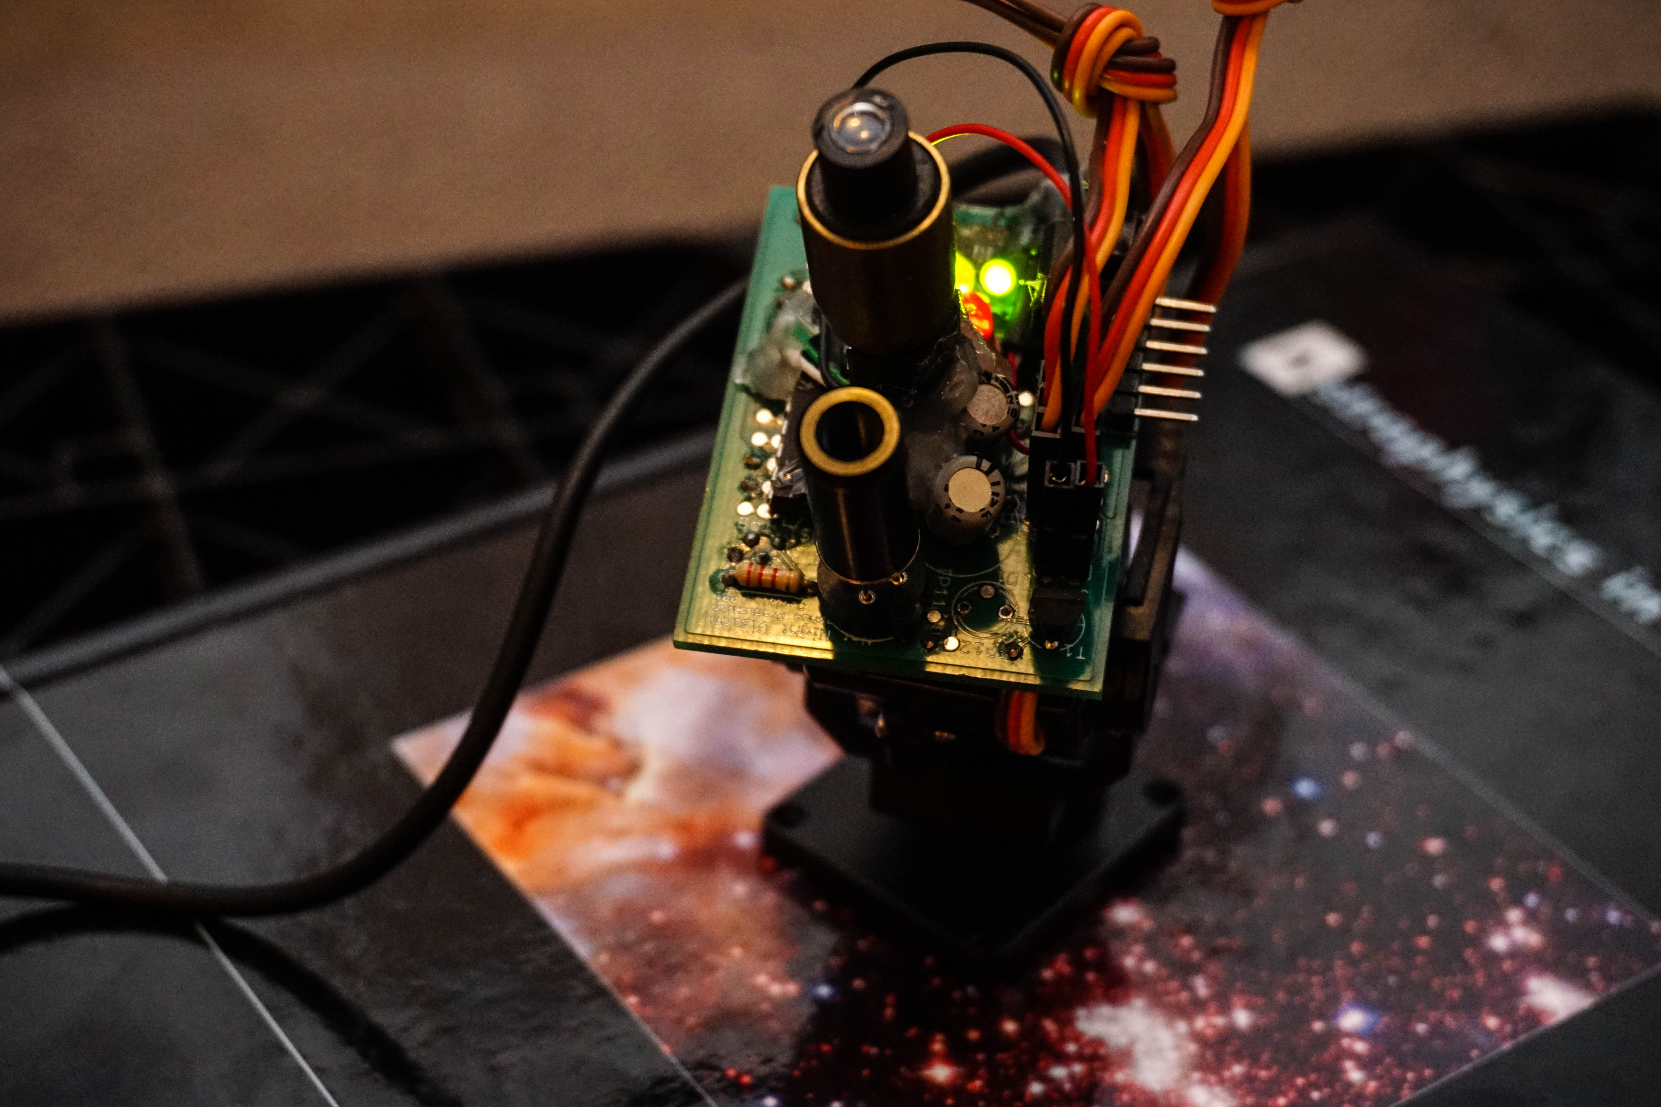
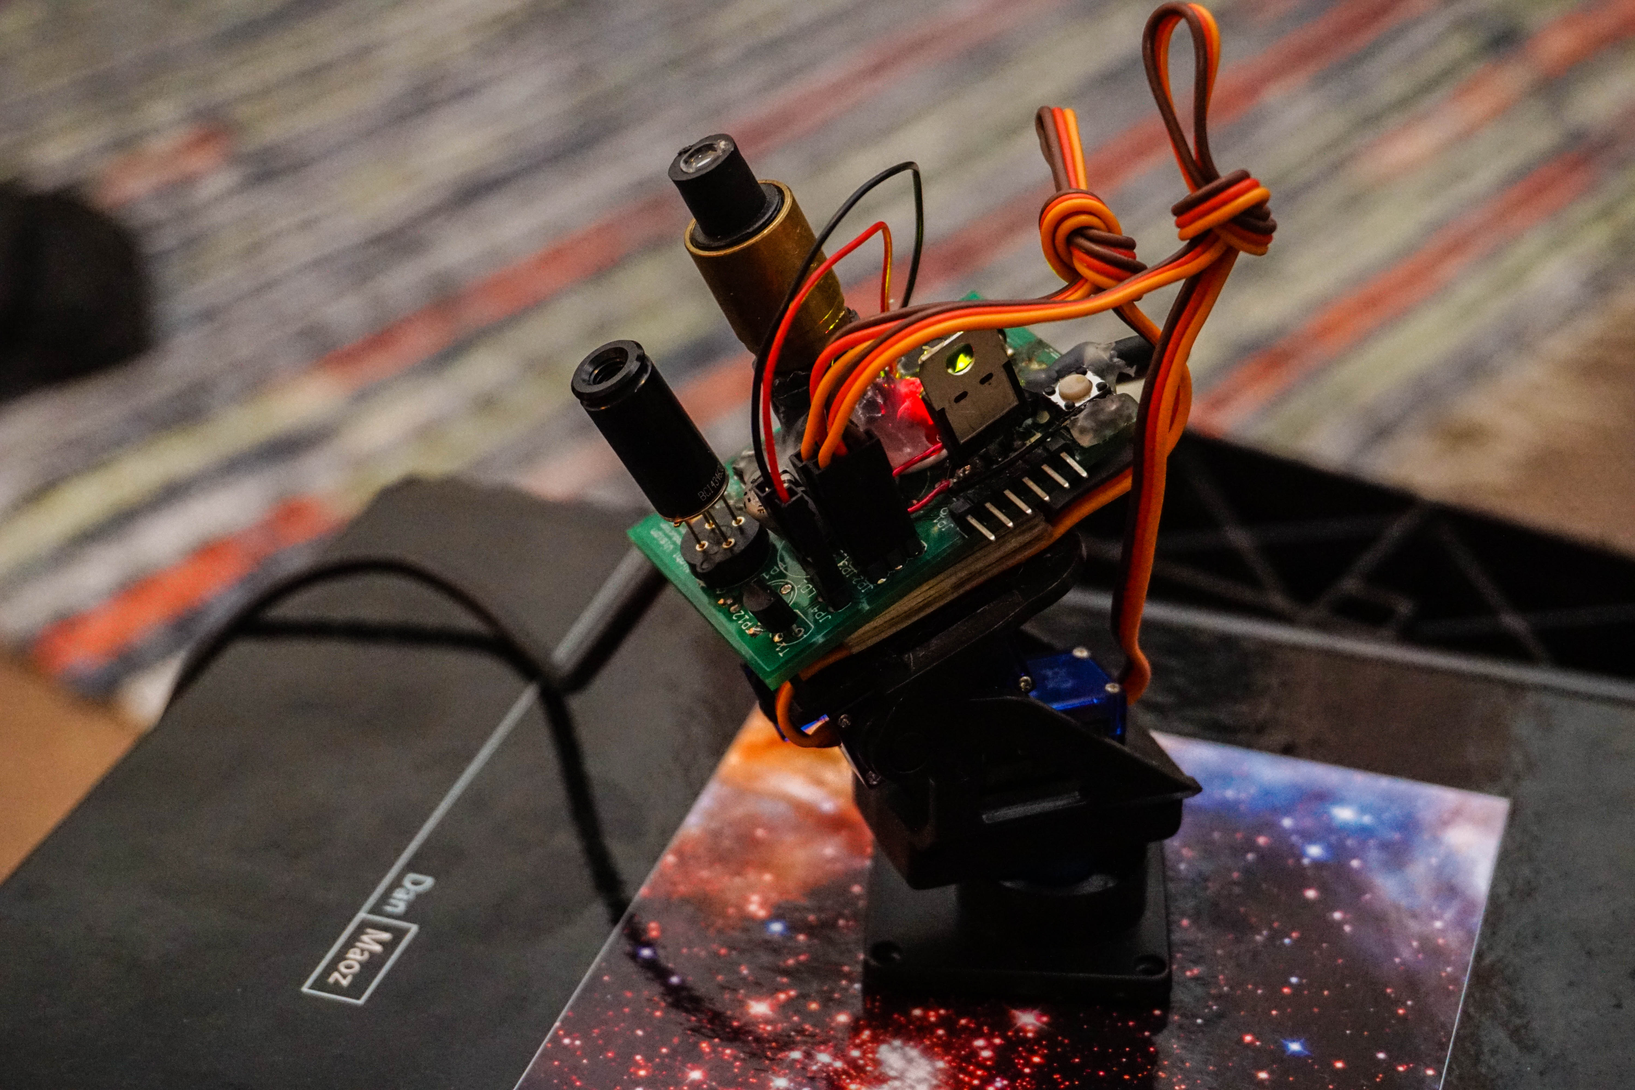
Design (PCB)
All physical design done in Eagle CAD (schematic capture and layout)
Final dimensions: 39mm by 51.5mm
Reworks needed on laser diode footprint and micro USB connector

Slide 8
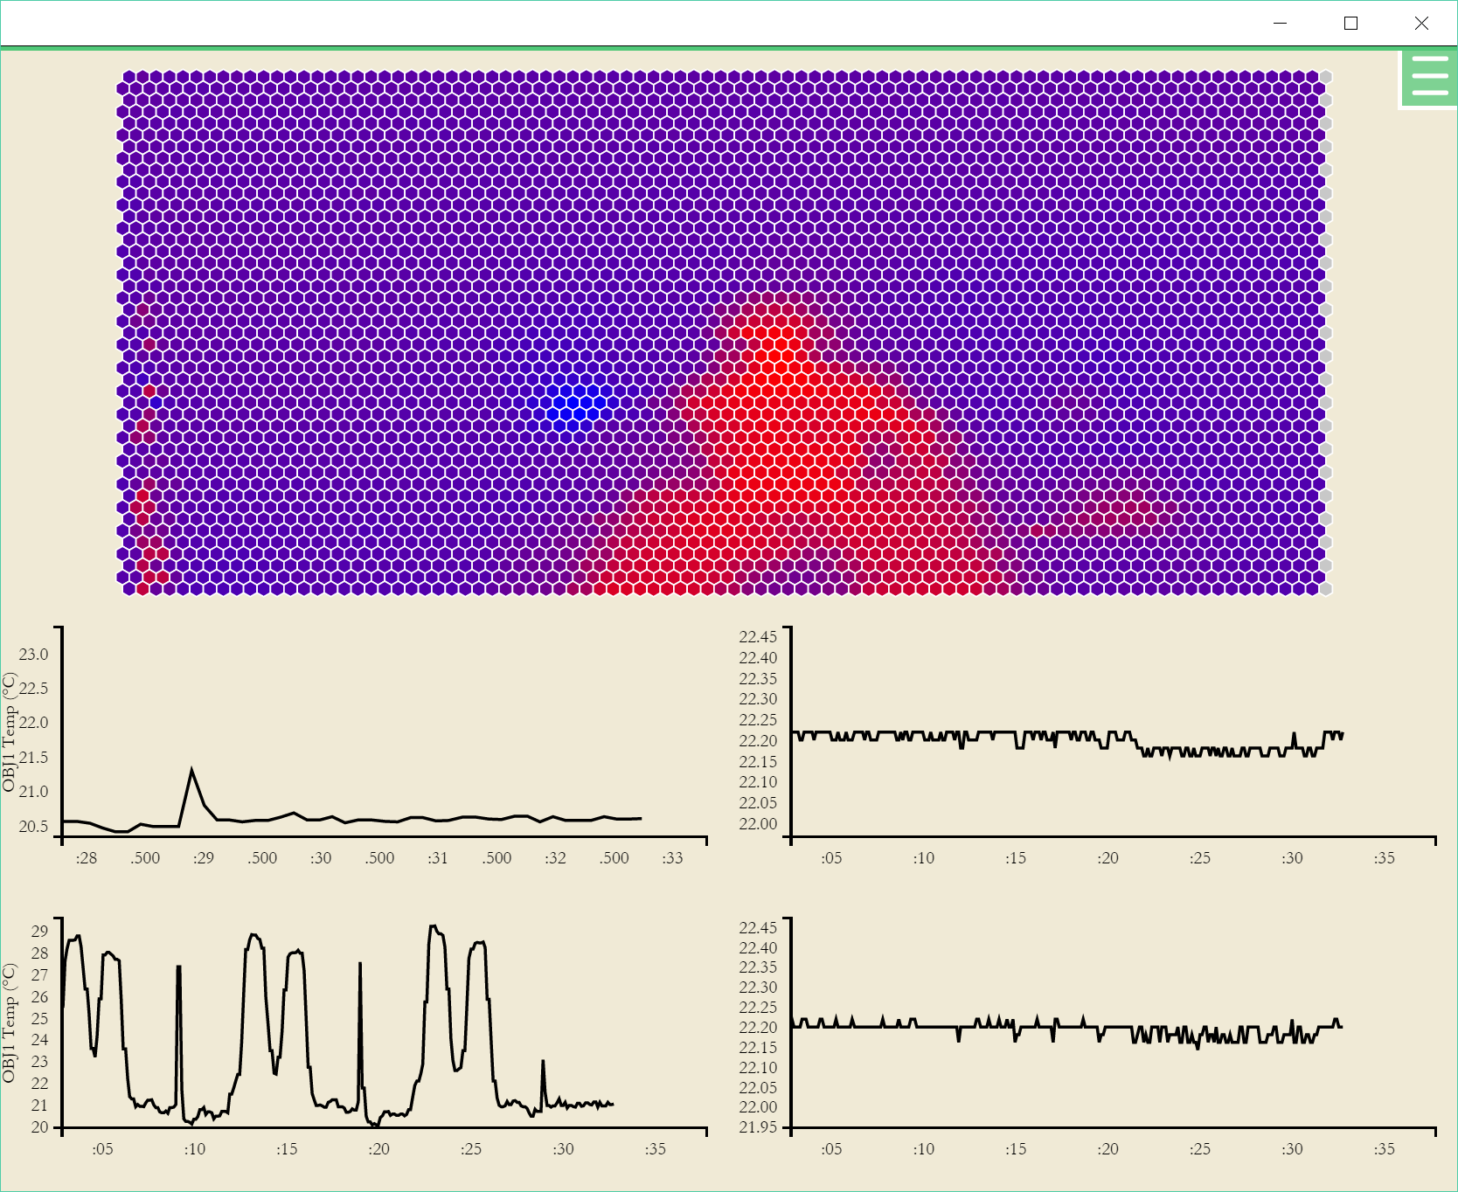
Results
Final system capable of both user-guided thermal measuring and pre-defined scan patterns over a 180° half sphere
Linear mapping of temperature readings heatmap pixels

Slide 9
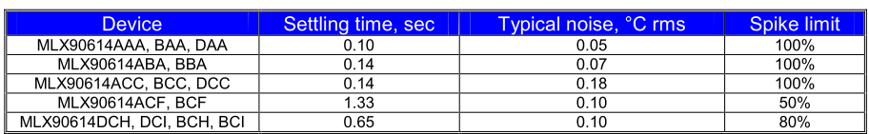
Issues/Future Improvements
MLX sensor with narrow FOV is slow (long settling time)
Issue when trying to quickly scan an area quickly
Temperature transients seen from previous measurements
Use MLX sensor’s ambient temperature measurements to correct for systematic temperature reading errors
Move MLX sensor and laser to separate PCB
Reduce load on gimbal
Reduce heating effects from power supply and MCU
Implement projection of thermal imaging data on top of visible spectrum
Additional camera sensor needed
Non-linear heatmap mapping of temperature readings to color

Slide 10
Appendix

Slide 11
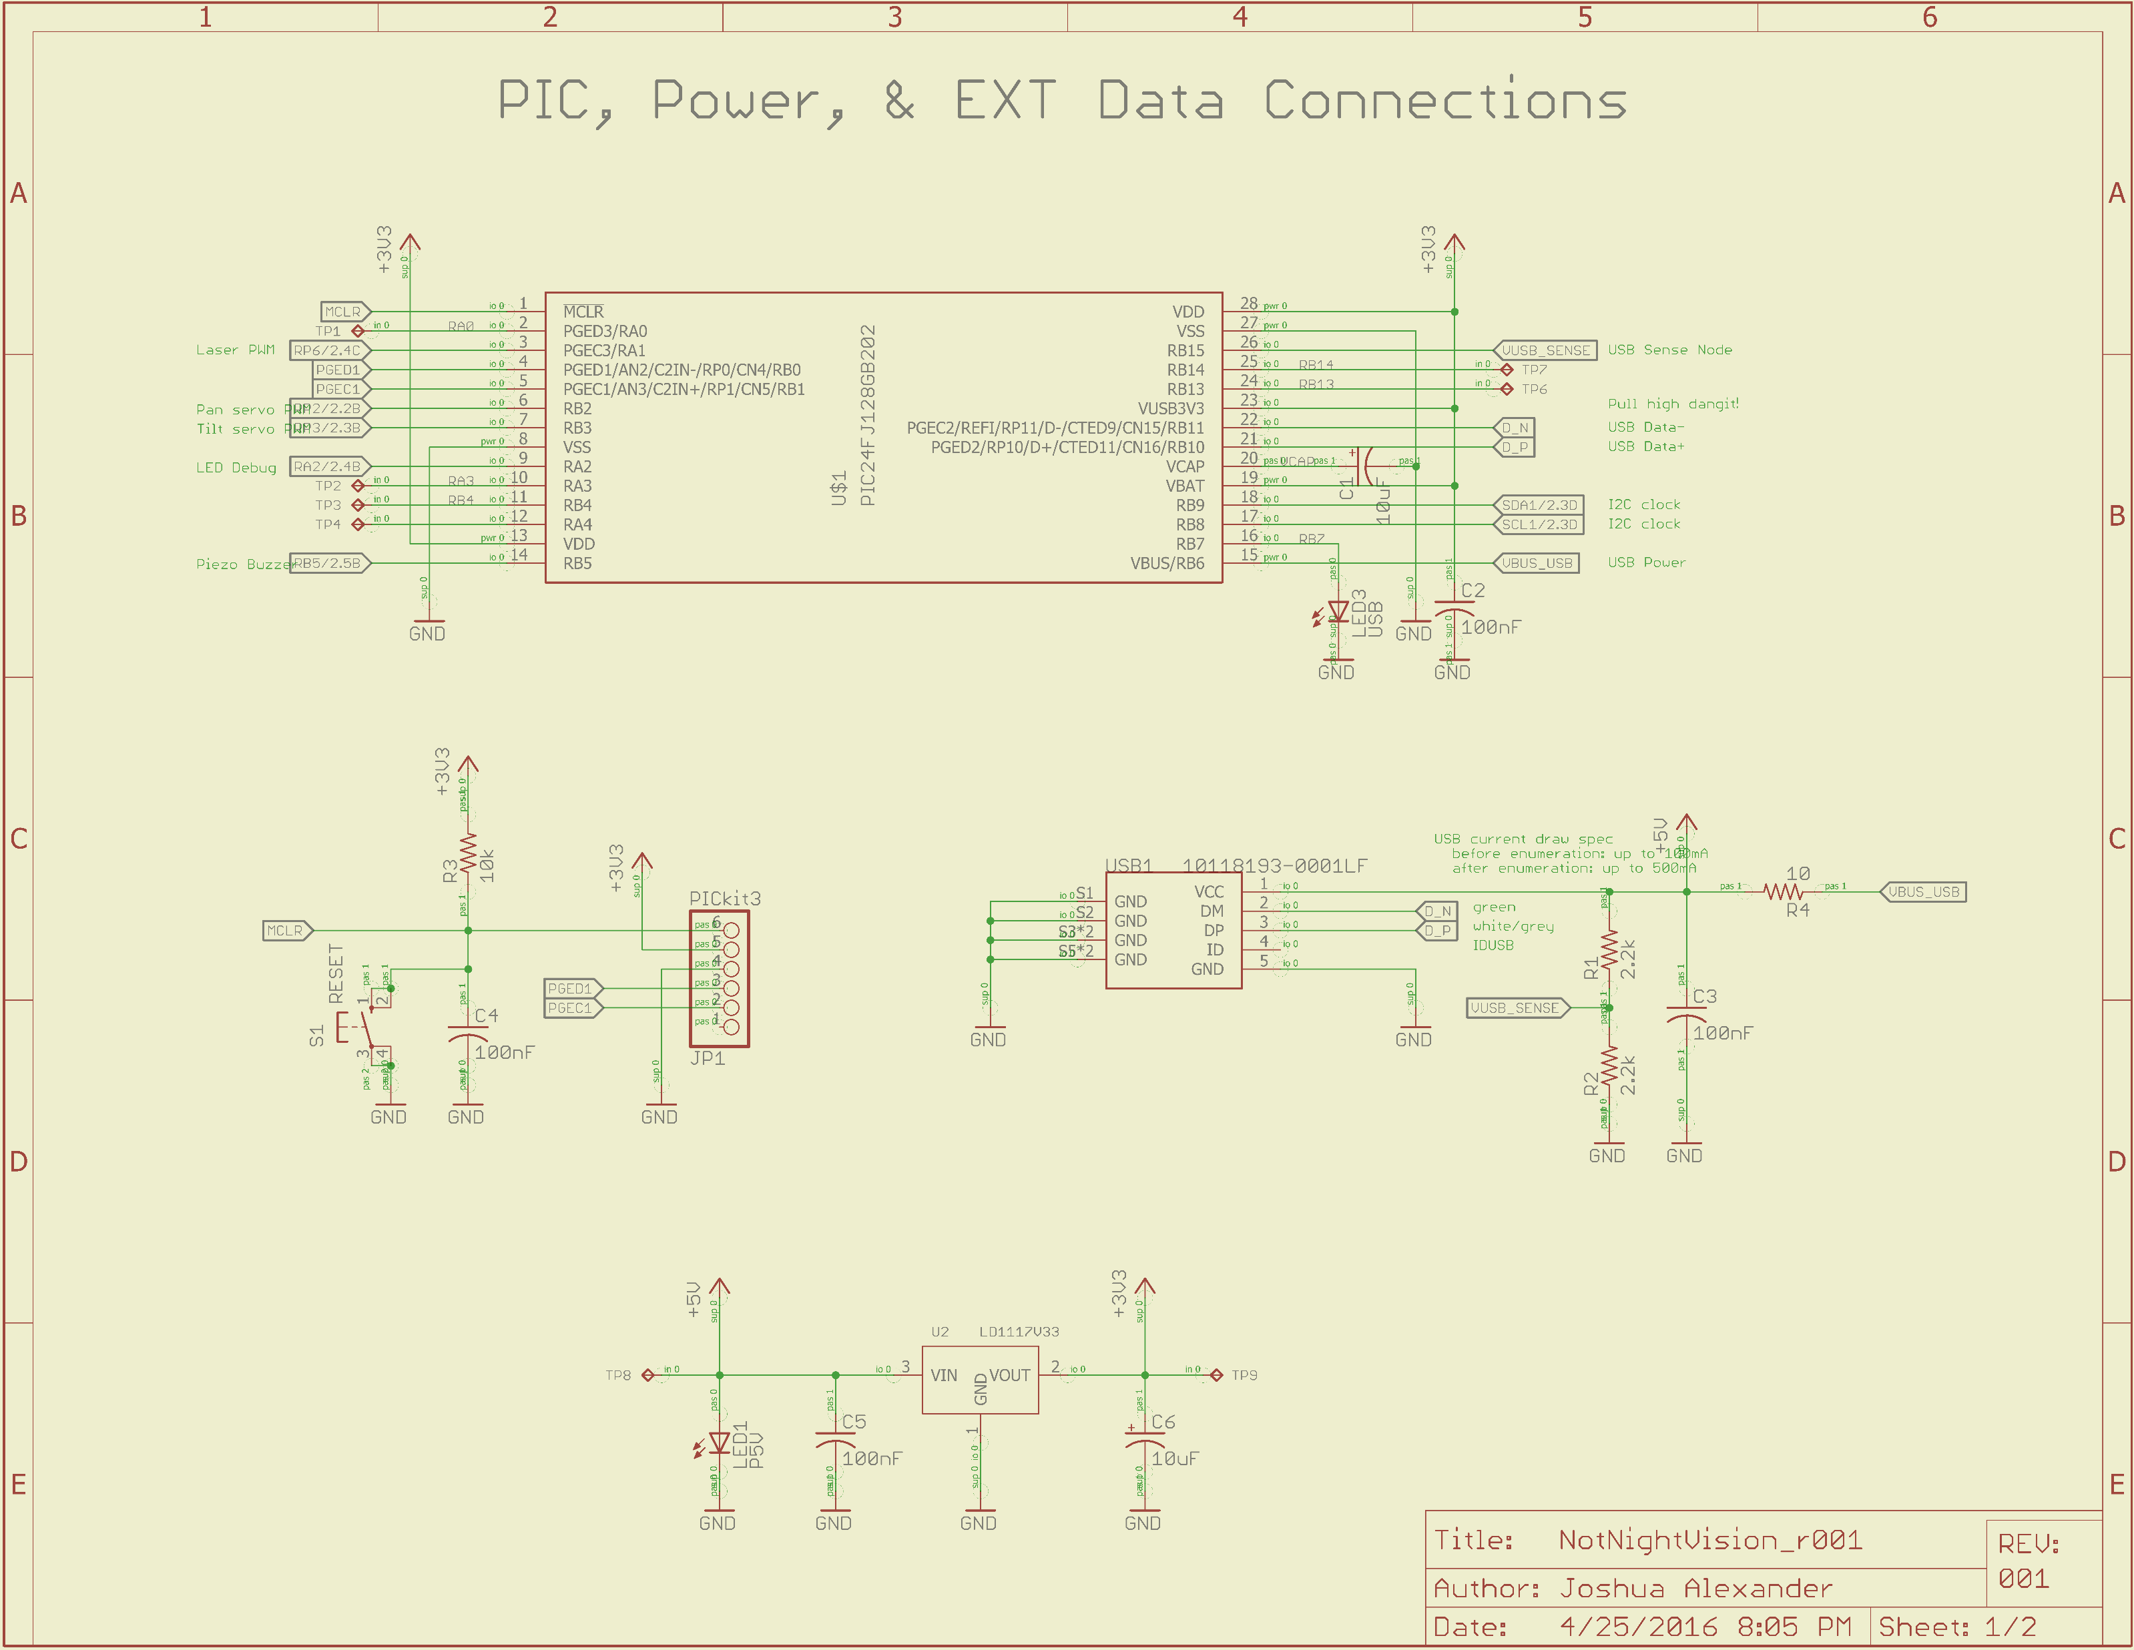

Slide 12
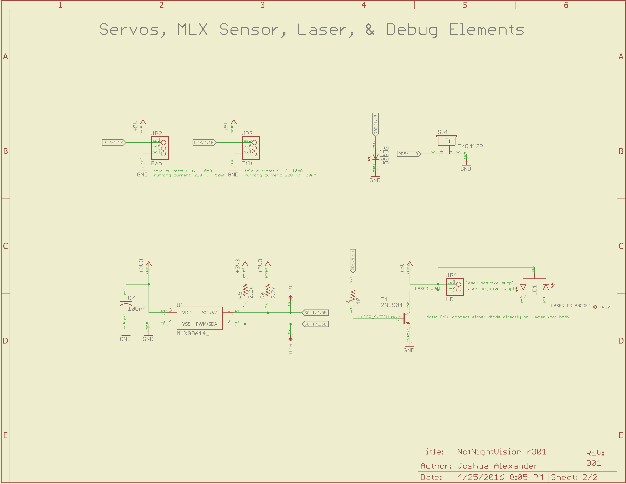

Slide 13
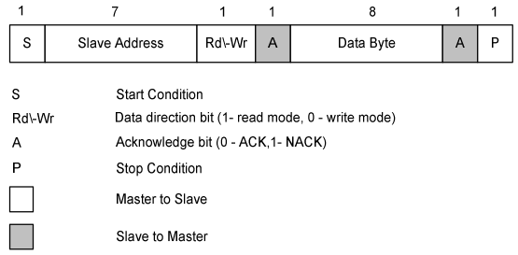
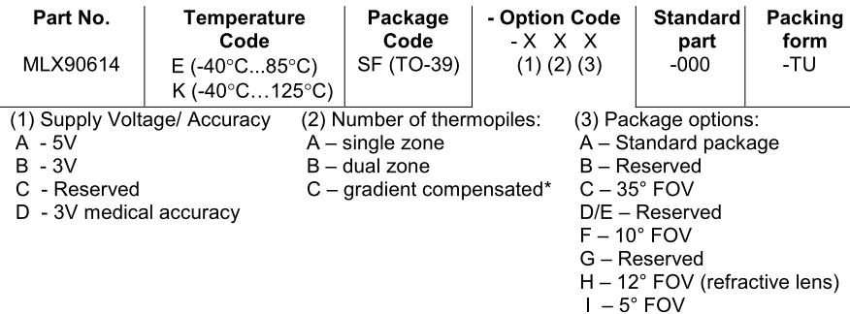

Slide 14
